Slide 1

Simple ML
How to get complex ML models and LLMs integrated with your projects quickly
Bugsmashers

Slide 2

Today’s Overview
Hugging Face
What is it?
Models
Datasets
Spaces
Live Demos
Groq APIs
Brief overview
Free LLM Providers
(100% legit working april 2025)
Live Demo

Slide 3
Hugging Face
MANY models are available on hugging face
Has a wide array of datasets
Useful for your own projects
Hosts interactable “spaces” to quickly test models / other things

Slide 4
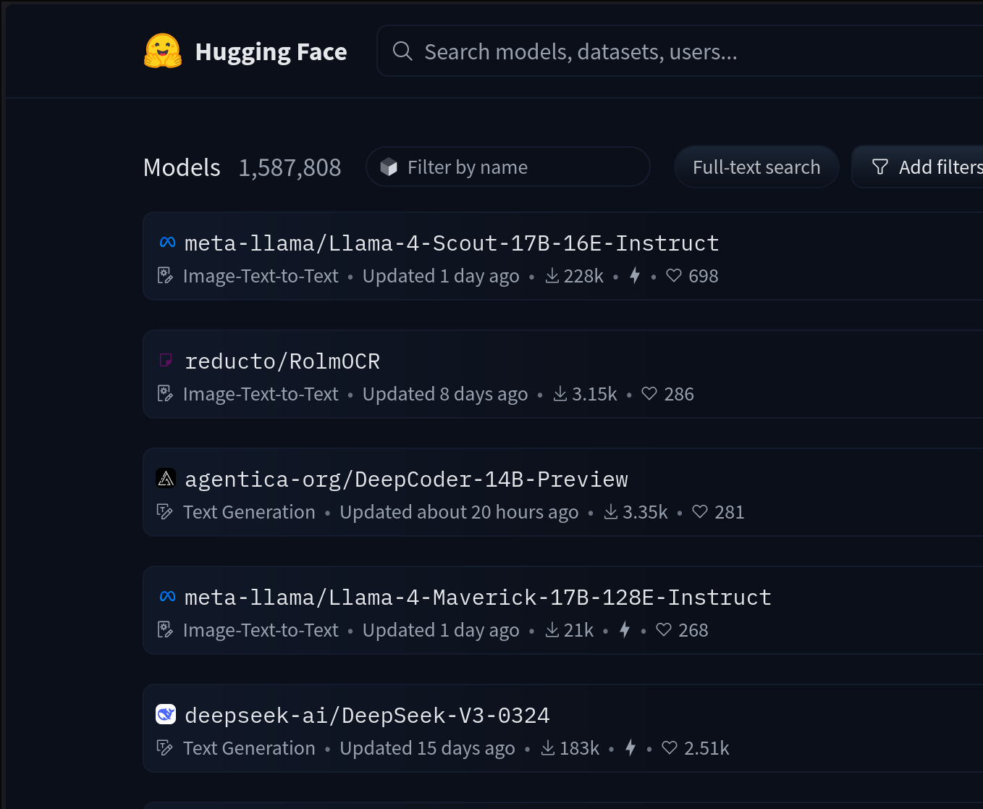
Models
Models are pretrained, ready to use
Targeted for specific use cases
Object detection
Text to speech
Code generation
Audio / Video upscaling
Legitimately anything else
Extremely quick to setup and use
Demo: Object detection
Notes:
https://huggingface.co/google/vit-base-patch16-224

Slide 5
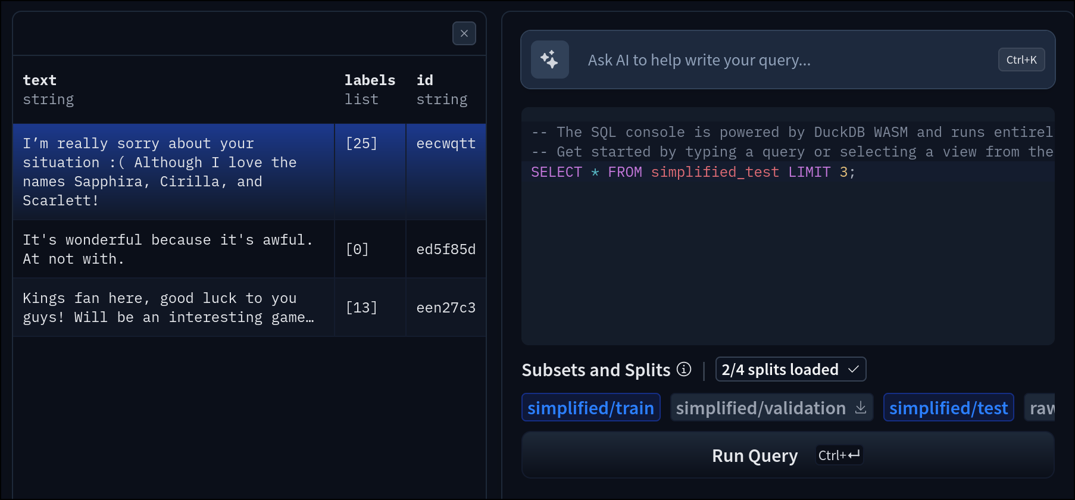
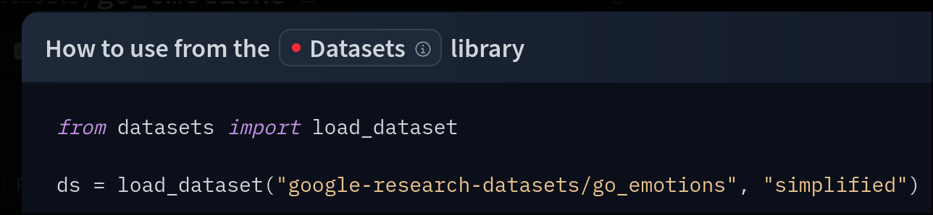
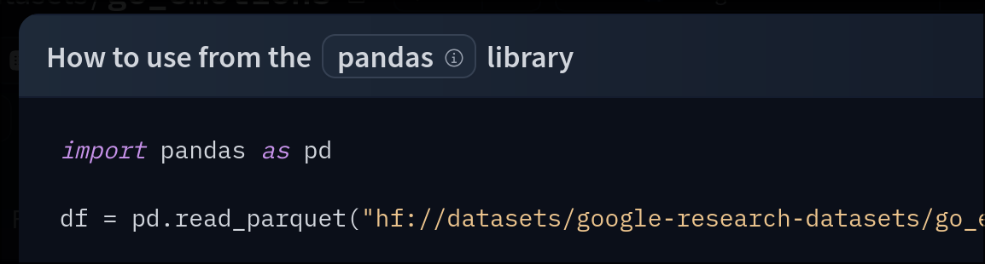
Datasets
Large amounts of datasets ready for you to use
Clean GUI alongside the data
See a sample of models trained using a given dataset
Built-in SQL dataset query-ier
Simple to import
Available in different formats
Look at: GoEmotions
Notes:
https://huggingface.co/datasets/google-research-datasets/go_emotions

Slide 6
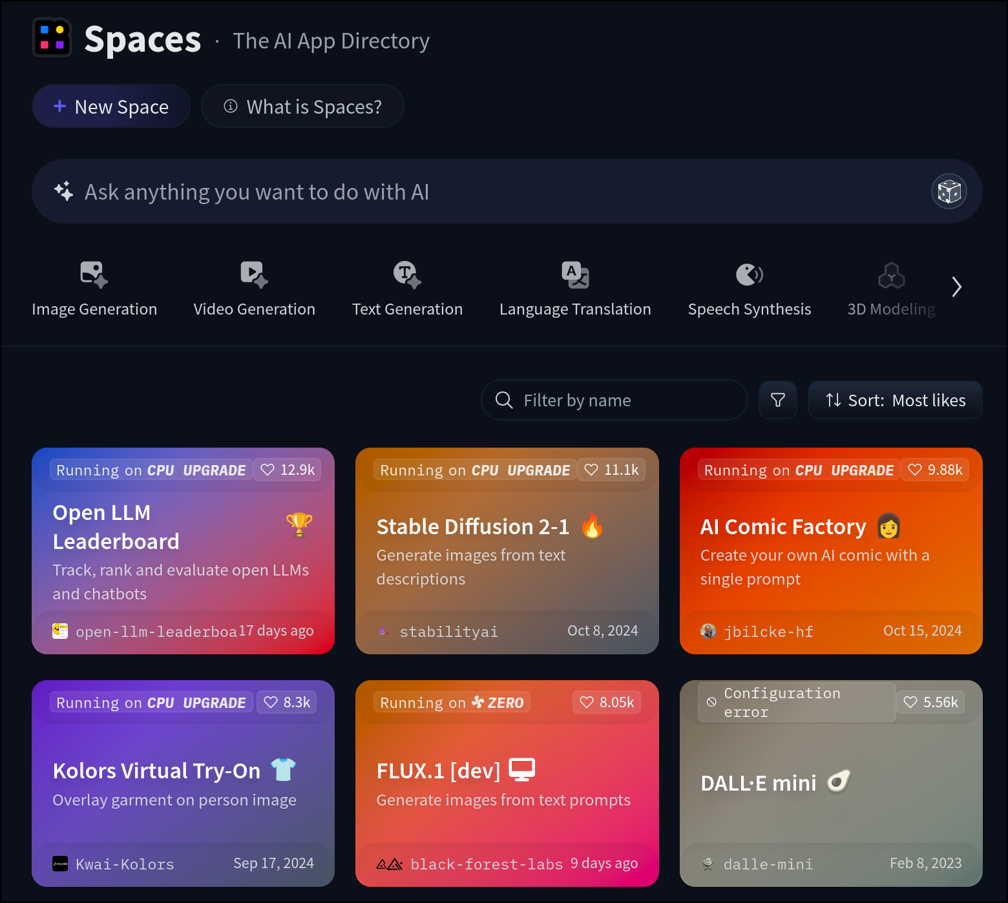
Spaces
Newer feature to hugging face
The whole app is hosted on Hugging Face
Highly customizable
Even quicker way to test out certain features of a model
Given an app for it exists
Demo: Background remover
Notes:
https://huggingface.co/spaces/not-lain/background-removal

Slide 7

Groq API
NOT TO BE CONFUSED WITH ELON’S “GROK”
Brief etymology lesson
Easy way to use decently powerful LLMs
Remember to exercise caution when handling API keys
Moderately generous requests per day and tokens per minute limits.
Demo: Test API call
Everything included is 100% free
S L P
Notes:
The word “grok” originated in Robert Heinlein’s 1961 novel Stranger in a Strange Land. Merriam Webster defines “grok” as “to understand profoundly and intuitively.” The Oxford English Dictionary defines “grok” as “[t]o understand intuitively or by empathy; to establish rapport with.”

Slide 9


Alternatives
For finding datasets:
Google dataset search
Kaggle
For LLM API’s
OpenAI (paid)
Deepseek (paid but significantly less so)
https://github.com/cheahjs/free-llm-api-resources (free)
Notes:
https://github.com/cheahjs/free-llm-api-resources

Slide 10
The end
DM me on discord if you have any questions John Rader @jarsnow

